Slide 1
Detection and tracking of 2D/3D objects for self-driving application
Yucheng Wang 11710211*
Keyu Huang 11710934
Tingting Zhang 11712531
Yuxi Liu 12032189

Slide 2
1
Research Question or Problem
2
Research Goals and Objectives
3
Research Design and Methods
4
Initial Results
5
Staffing Plan & Timeline
6
Reference

Slide 3
1
Research Question or Problem
Multiple Object Tracking(MOT) has always been a problem which is hard to proceed a satisfactory result balancing the accuracy and efficiency.
Traditionally, MOT are solved by Multiple Hypothesis(MHT), the Joint Probabilistic Data Association(JPDA) filters. Delay, high complexity of time.
Considering the facts mentioned above, distinct methods (DEEP_SORT, DEEP_SORT +YOLOv3) which could improve the performances will be implemented on our data set in this project. The results would be optimized by comparison

Slide 4
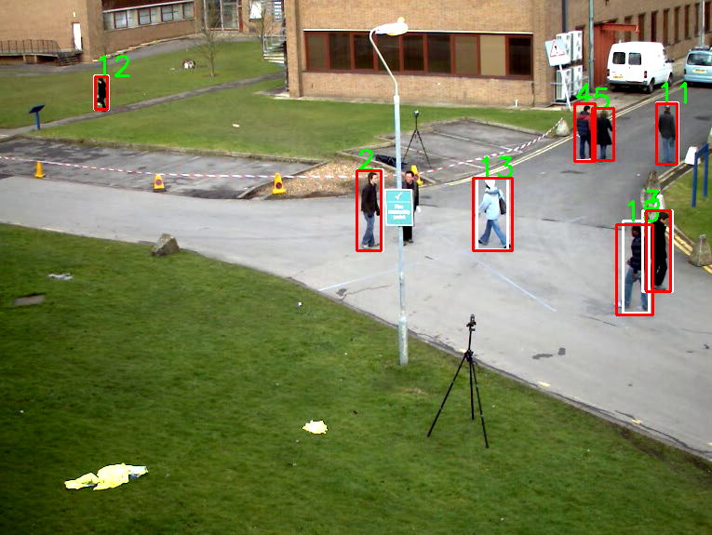
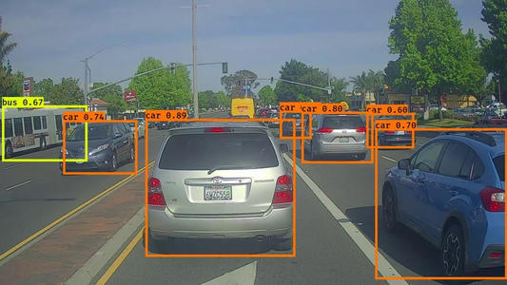
2
Research Goals and Objectives
Obtain original data set(video clip)
Apply Deep_SORT and Deep_SORT+YOLOv3
Comparisons between the results
Optimization

Slide 5
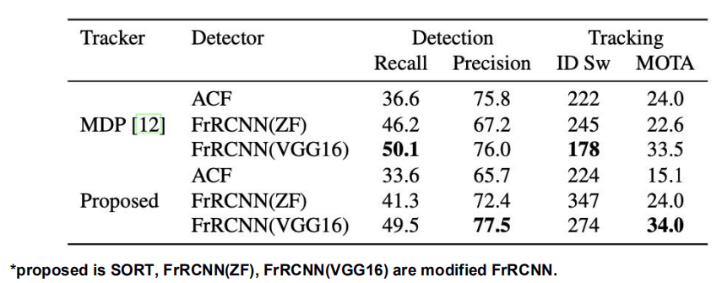
3
Research Design and Methods
SORT
1) Detection: SORT use FrRCNN detection method
2) Data Association It uses the Hungarian assignment algorithm for data association.
Deep_SORT
1) Track Handling and State Estimation
2) Assignment Problem
3) Matching Cascade
4) Deep Appearance Descriptor

Slide 6
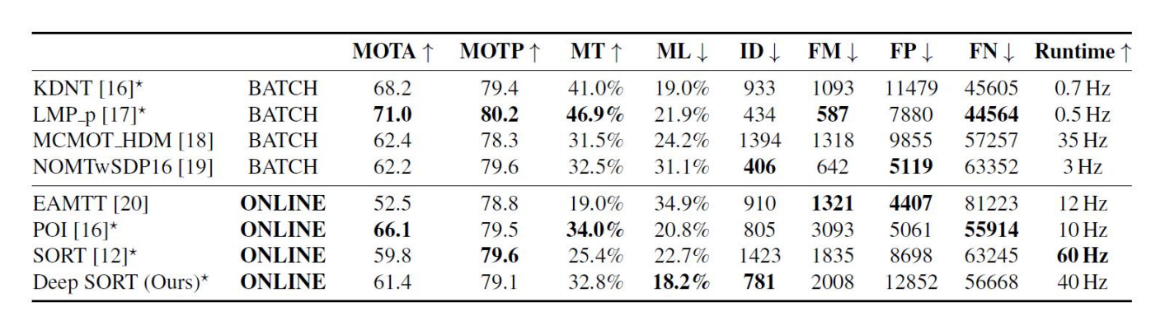
4
Initial Results
Compared with other algorithms, sort already achieve the higher MOTA score for the online trackers. And
the deep sort algorithm goes further returns the fewest number of identity switches of all online methods
while maintaining competitive MOTA scores, track fragmentations, and false negatives.
Although deepsort has achieved good results, there is still space for improvement. On the one hand
its excellent performance largely depends on the quality of detections. If the detection data is complicated,
more complicated preprocessing may be required. On the other hand, only the distance relationship is used
in the motion matching degree, not the real motion information. I think we can combine speed information
to solve the Identity switches when similar people meet.

Slide 7
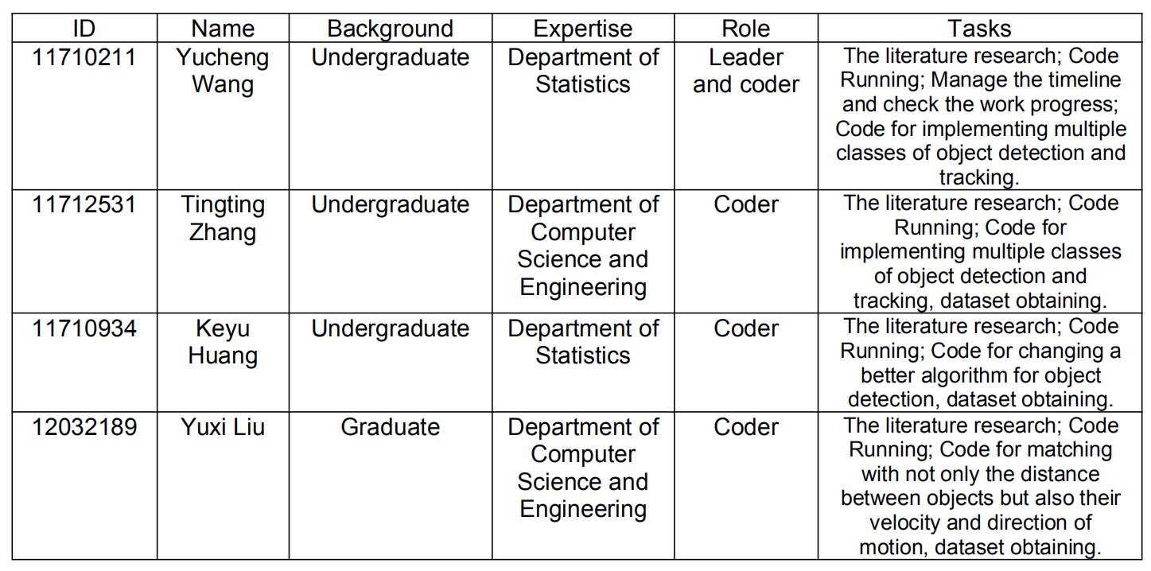
5
Staffing Plan & Timeline

Slide 8
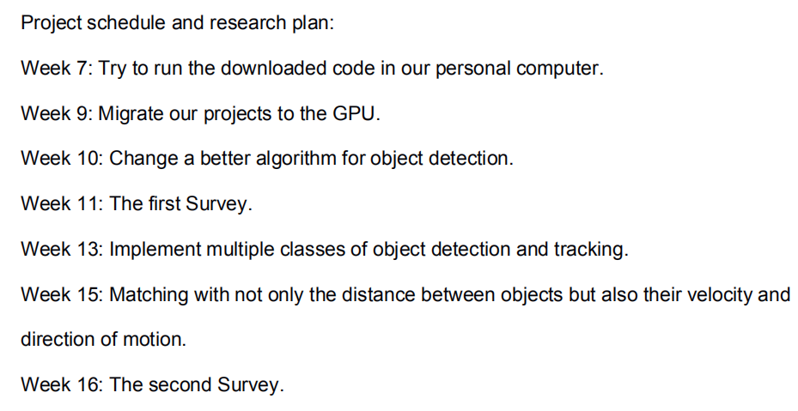
5
Staffing Plan & Timeline

Slide 9
6
Reference
[1] N. Wojke, A. Bewley, and D. Paulus. “Simple online and realtime tracking with a deep association metric”, arXiv preprint arXiv:1703.07402, 2017.
[2] N. Wojke and A. Bewley, “Deep cosine metric learning for person re-identification,” in Proc. WACV. IEEE, 2018, pp. 748–756.
[3] A. Bewley, G. Zongyuan, F. Ramos, and B. Upcroft, “Simple online and realtime tracking,” in ICIP, 2016, pp. 3464–3468.
[4] L. Leal-Taix´e, A. Milan, I. Reid, S. Roth, and K. Schindler, “MOTChallenge 2015: Towards a Benchmark for Multi-Target Tracking,” arXiv preprint, 2015.
[5] F. Yu, W. Li, Q. Li, Y. Liu, X. Shi, and J. Yan, “Poi: Multiple object tracking with high performance detection and appearance feature,” in ECCV. Springer, 2016, pp. 36–42.
[6] https://github.com/nwojke/deep_sort
[7] https://zhuanlan.zhihu.com/p/114349651

Slide 10

Thanks for Listening!

